Slide 1
Capstone Project
Sales Analysis Report
. - By Anita

Slide 2
Objective and Goal
Objective: The objective of a Power BI dashboard for sales analysis is to provide a comprehensive view of sales data and performance metrics to support informed decision-making
Goal: These goal of this dashboard is to empower businesses with the ability to make strategic decisions based on real-time data analysis and to stay competitive in the dynamic automobile market.

Slide 3

Analysis Scope
1.Analyze retail sales data: Understand sales trends, identify top-performing products, and evaluate sales performance across different regions or stores.
Forecast future sales trends: Use historical data to predict future sales, which can help in inventory management and marketing strategies.
3.Track Key Performance Indicators (KPIs): Monitor critical KPIs such as units sold, revenue, gross margin, and year-over-year growth.
4.Visualize data for better insights: Create visual representations of data to identify patterns, outliers, and correlations that might not be evident in raw data.
5.Enhance decision-making: Provide actionable insights that can help stakeholders make data-driven decisions regarding marketing, sales strategies, and customer engagement
6.Optimize marketing strategies: Analyze customer preferences and buying behavior to tailor marketing efforts and improve customer acquisition and retention.

Slide 4
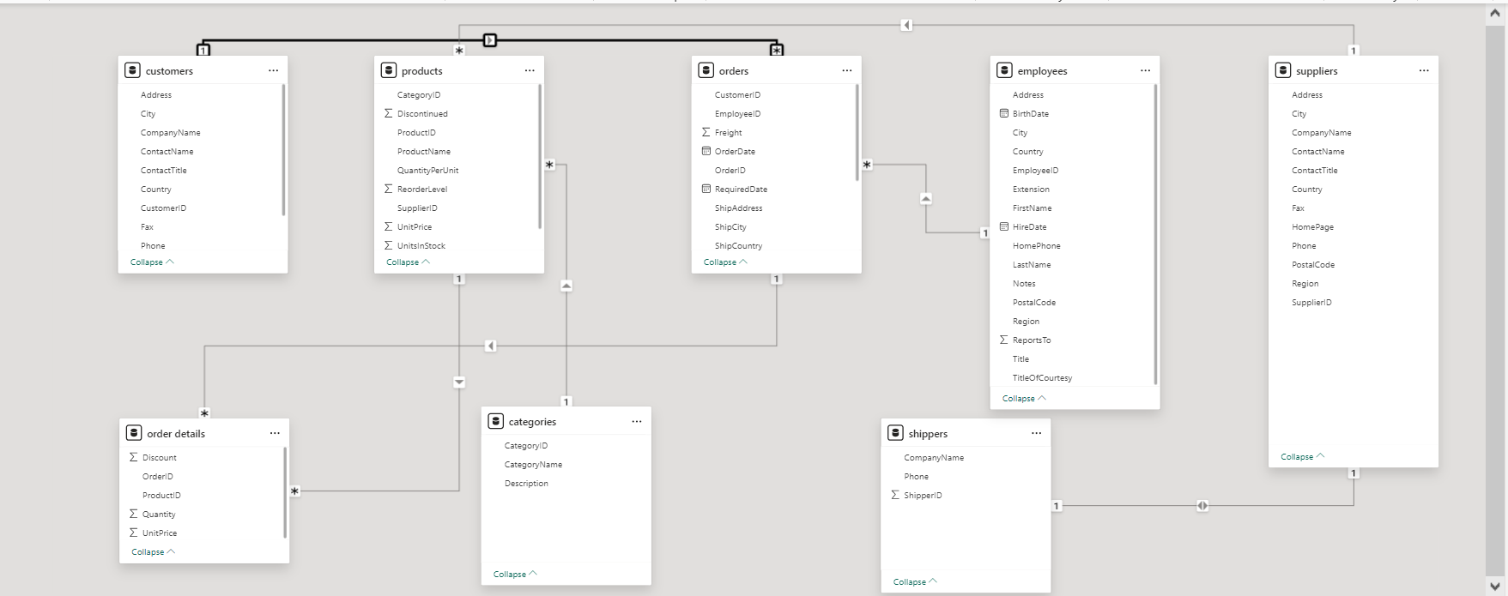
ER Diagram

Slide 5
Power BI Problem Statement

Slide 6
Table Name | Brief Description
Suppliers | Suppliers and vendors of company
Customers | Customers who buy products from company
Employees | Employee details of Northwind traders
Products | Product information
Shippers | The details of the shippers who ship the products from the traders to the end-customers
Orders and Order_Details | Sales Order transactions taking place between the customers & the company
Data Table

Slide 7
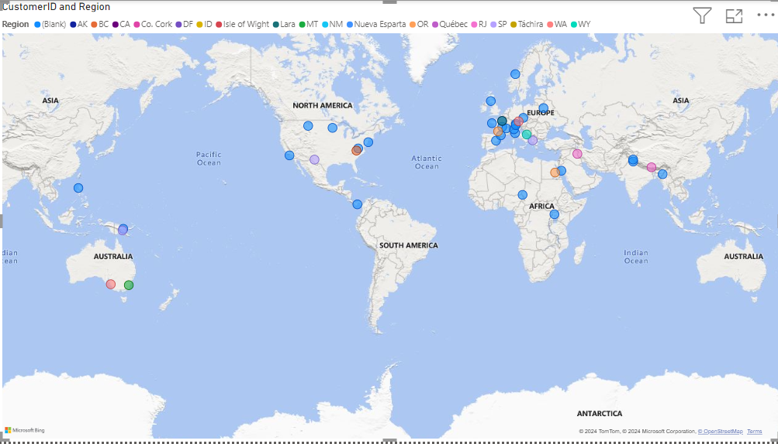
Customer Analysis
Customer distribution vary across different regions
Maps: Display the geographical distribution of customers using color intensity or bubble size to represent customer density.

Slide 8
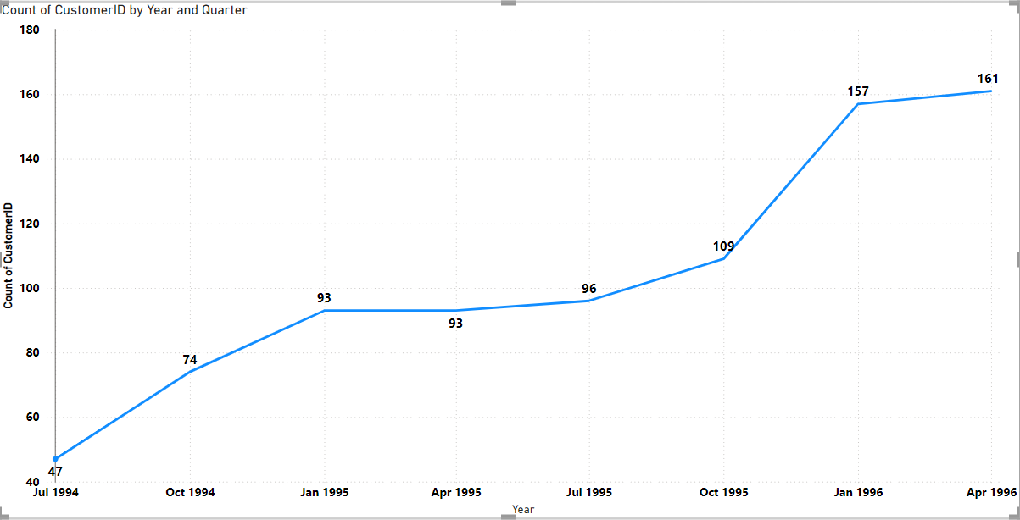
Customer Acquisition Rate
Line trends charts shows increasing trend of customer acquisition rate over the time

Slide 9
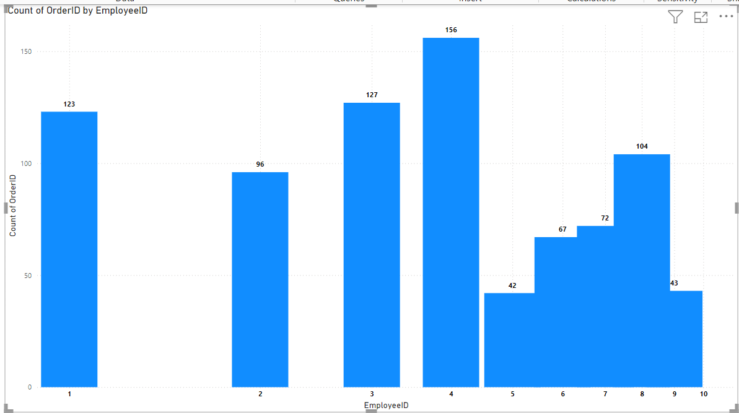

Slide 10
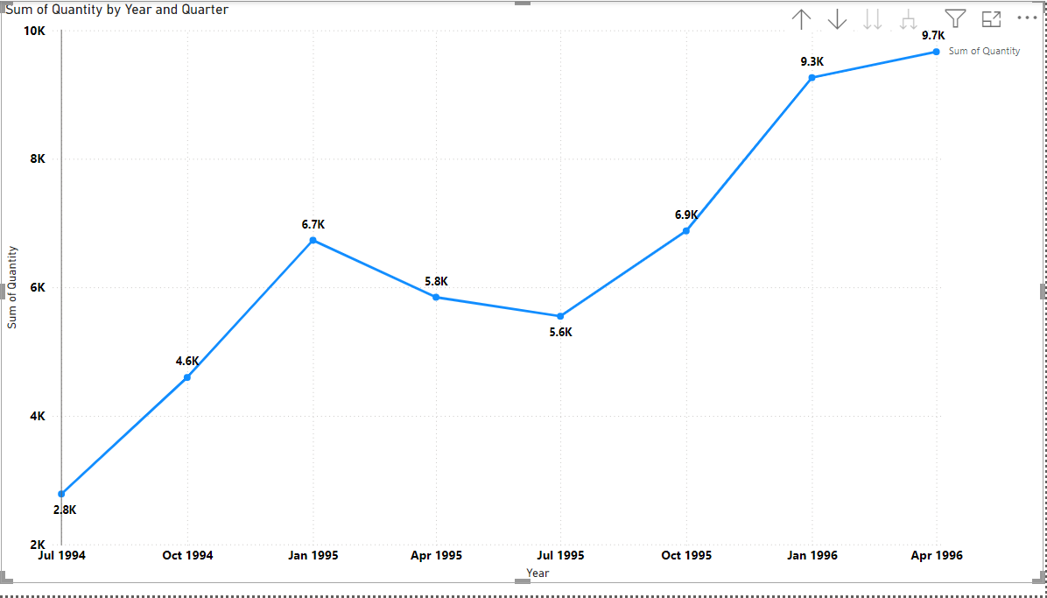
Order Volume over time
Trend of Order volume over the time

Slide 11
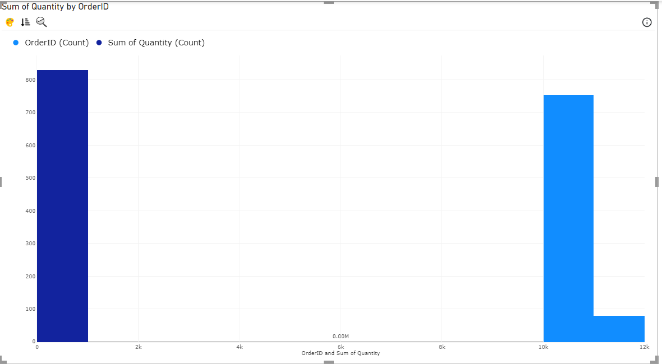
Distribution of Order value

Slide 12
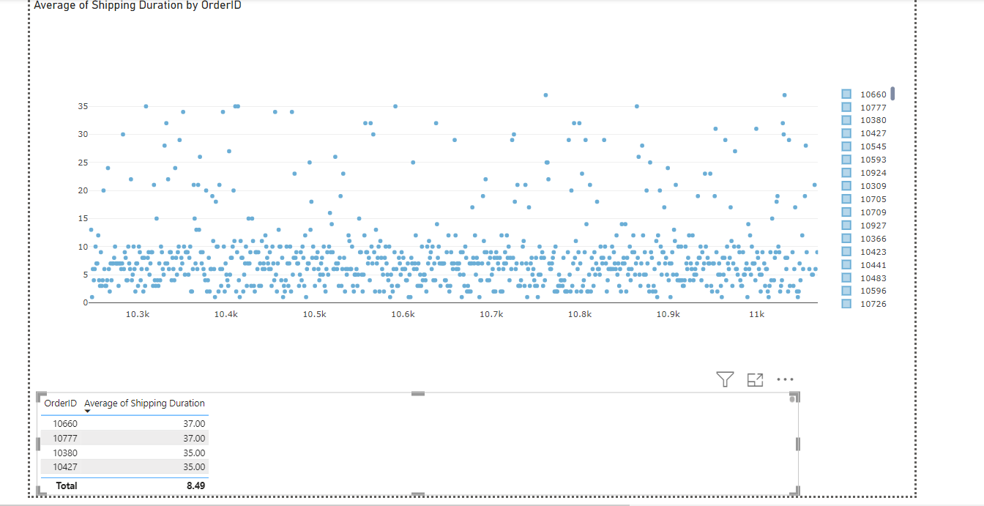
Avg Shipping duration by Order ID

Slide 13
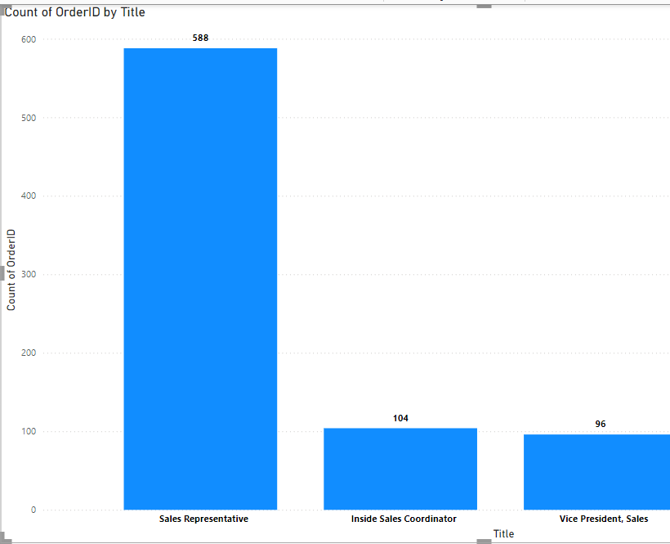
Employee Analysis
Employee productivity vary across different departments or job roles

Slide 14
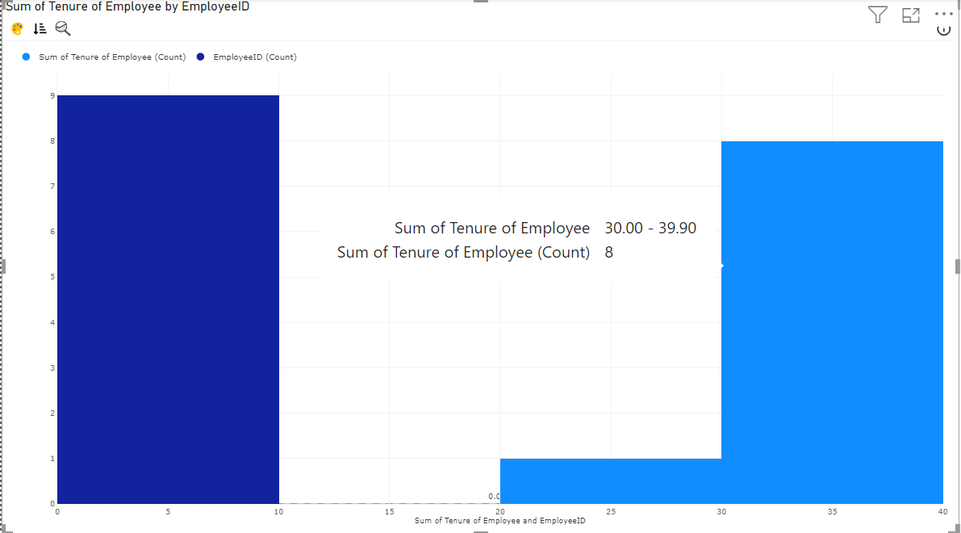
Employee Tenure

Slide 15
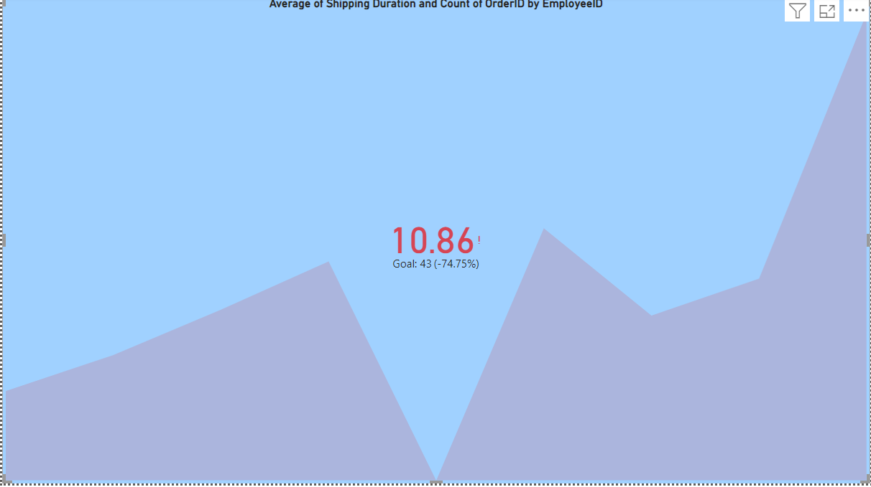
Employee Performance Ratings

Slide 16
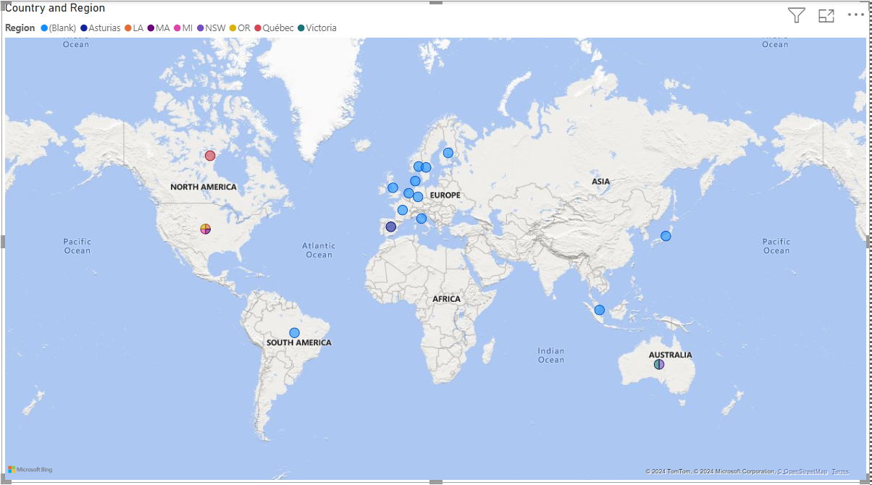
Geographical distribution of suppliers using a map

Slide 17
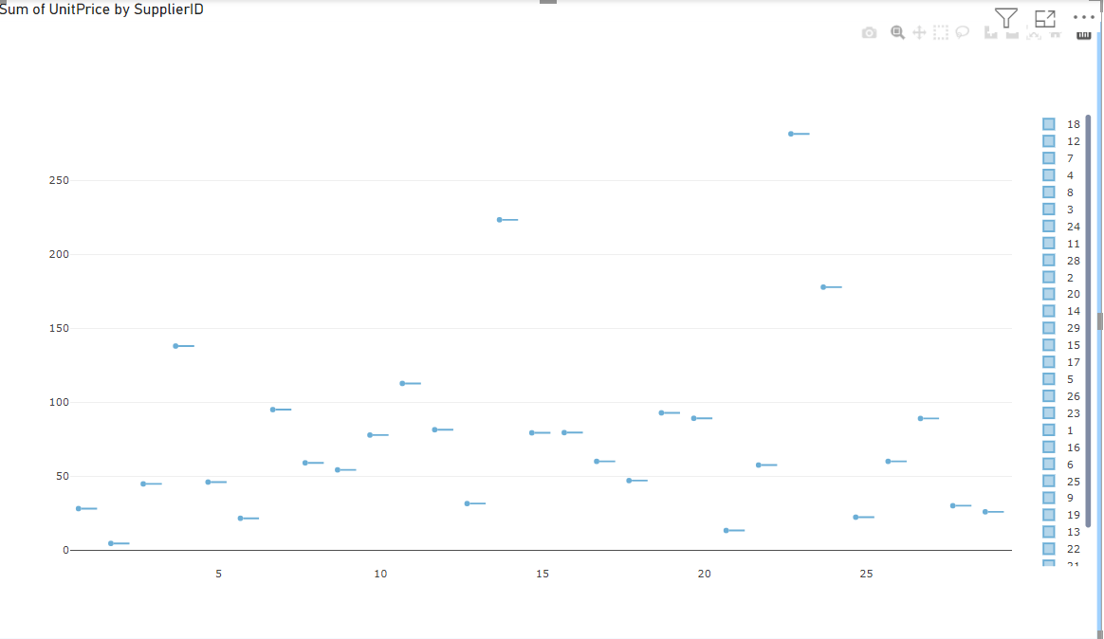
Pricing structure vary across different suppliers

Slide 18
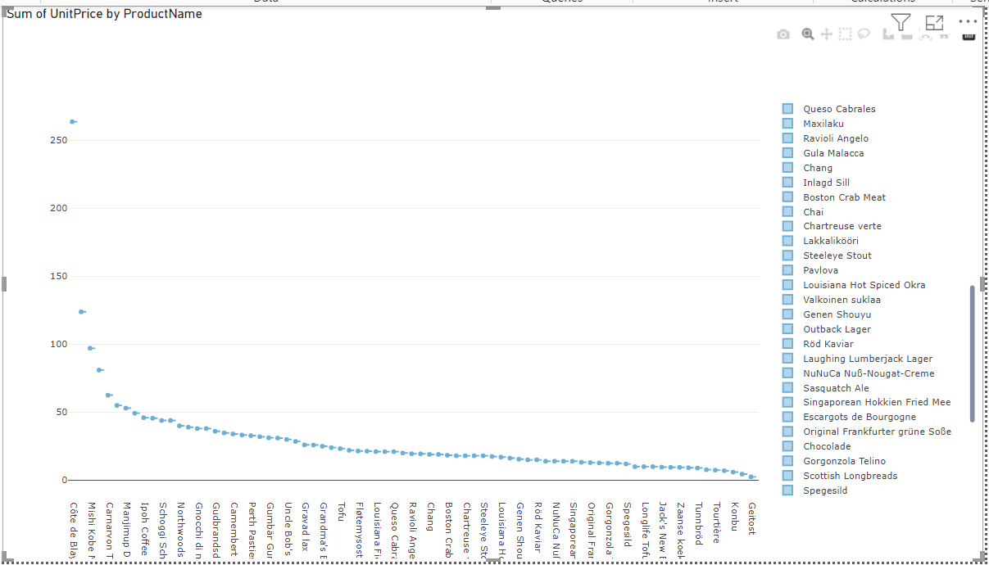
Pricing distribution of products using a box plot

Slide 19

Sales Analysis Report Summary
This summary provides a comprehensive overview of the sales analysis report, helping stakeholders understand the current performance and potential areas for improvement in sales strategies.
Key Findings
Total Sales: Summarize the total sales revenue over the analyzed period.
Sales Trends: Highlight any significant trends in sales volume or revenue over time.
Top Performing Products/Services: Identify the best-selling products/services based on sales volume or revenue.
Geographical Analysis: Discuss sales performance across different regions or markets.
Customer Segmentation: Analyze sales by customer segments , such as demographics or buying behavior.

Slide 20

Recommendations
Prioritize customer retention strategies to enhance loyalty.
Optimize marketing efforts based on ROI analysis.
Monitor and adjust inventory levels based on product performance and seasonality.
Implement data-driven decision-making processes to drive sales growth.

